Slide 1

Get_cdip

Slide 2
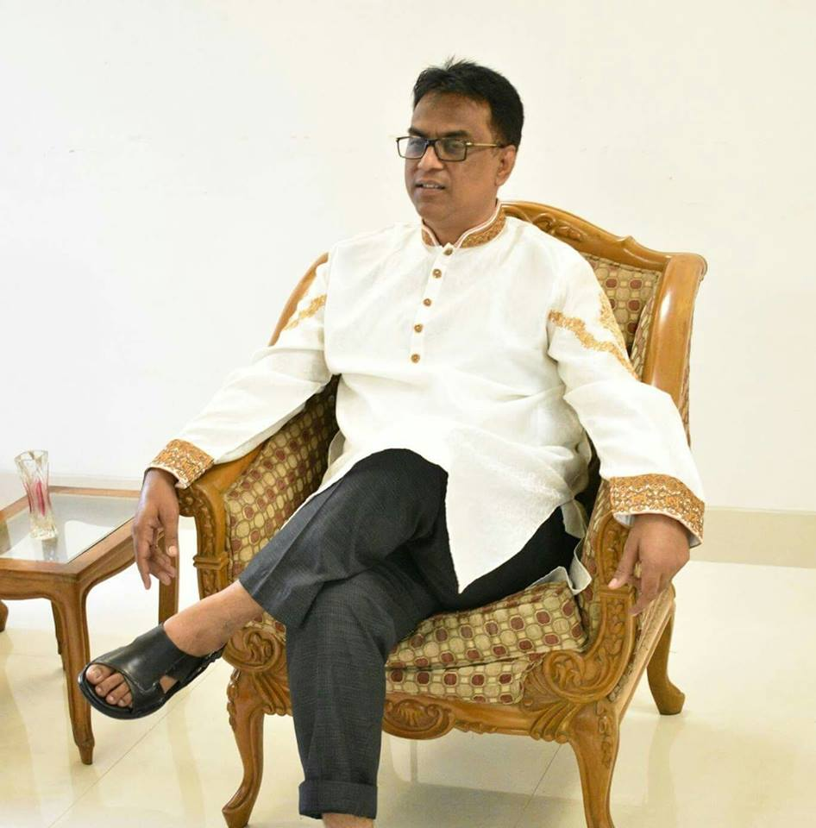
Supervisor
Suman Ahmmed
Asst. Professor, CSE | Director, Center for Development of IT Professionals (CDIP)

Slide 3
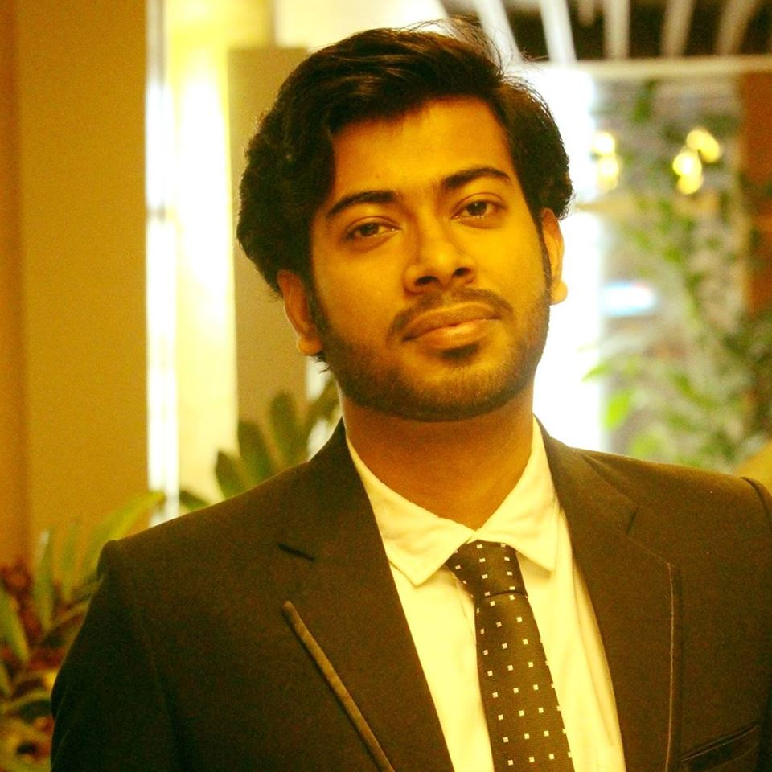
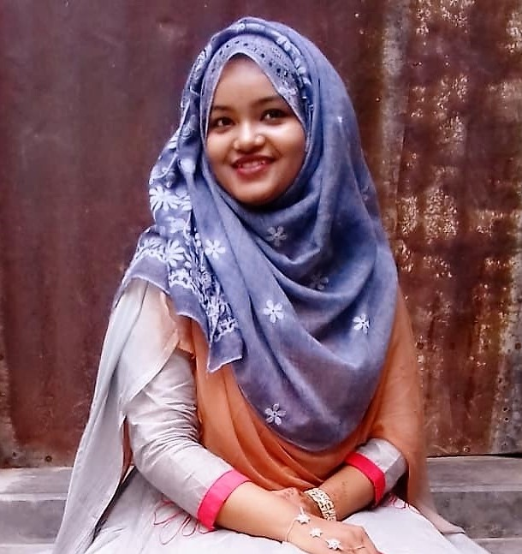


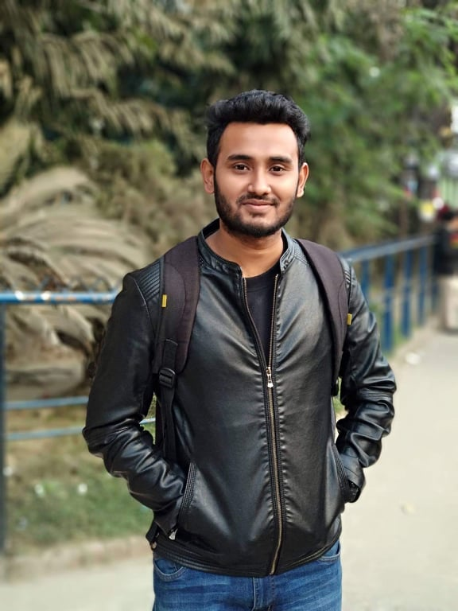
Shubhra Roy
011142070
Salma Sultana
011151140
Sagor Sarker
011 143 076
Rubina Parvin Noor
011161061
Mehedi Hasan
011 143 098

Slide 4

objectives
The students of CDIP will have a personal website for their documentation and assignment. They will have security for their personal information.
User will ask any type of questions of IT or Industry related problem and experts can answer their question using our website.

Slide 5
Target users
Present students of CDIP
Mentors/Teachers
Industry people

Slide 6
Feature list
Assignment upload and authorization .
Question and answer system .
Industry problems
Documentation and easy search
Chatting

Slide 7
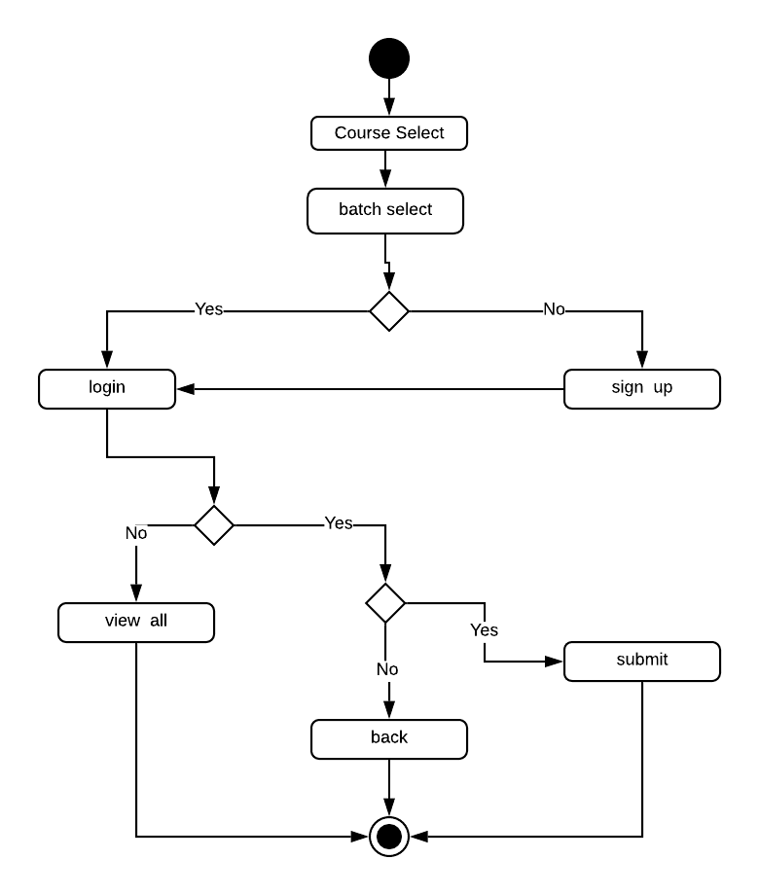
Assignment
Assignment upload by instructor.
Student can Submit assignment.
Due date.

Slide 8

Chatting with course instructor
Live chat
Voice call
File sharing

Slide 9
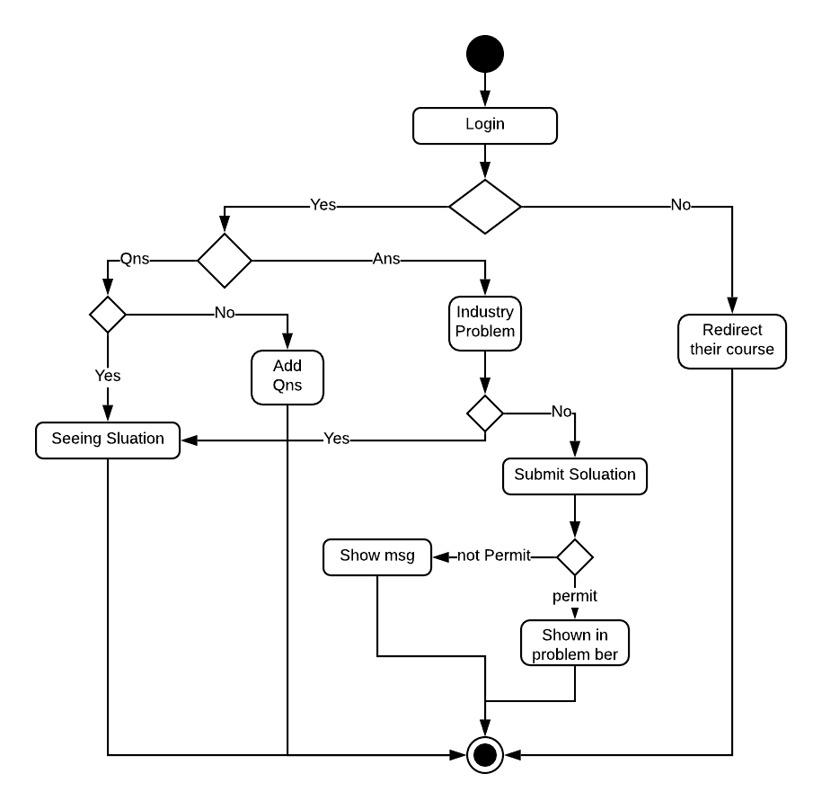
Industry problem and solution
Problems provided by Ex-Student who works on different Industries.
This feature only for 'Python and Big Data Analysis' course students.
Solution will be provided by admin.

Slide 10
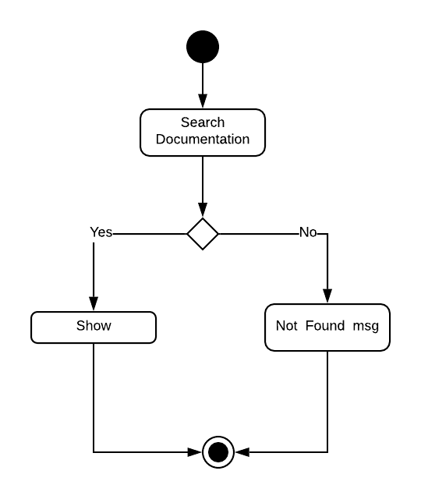
Documentation
Tutorials Upload
Class records
Slides

Slide 11
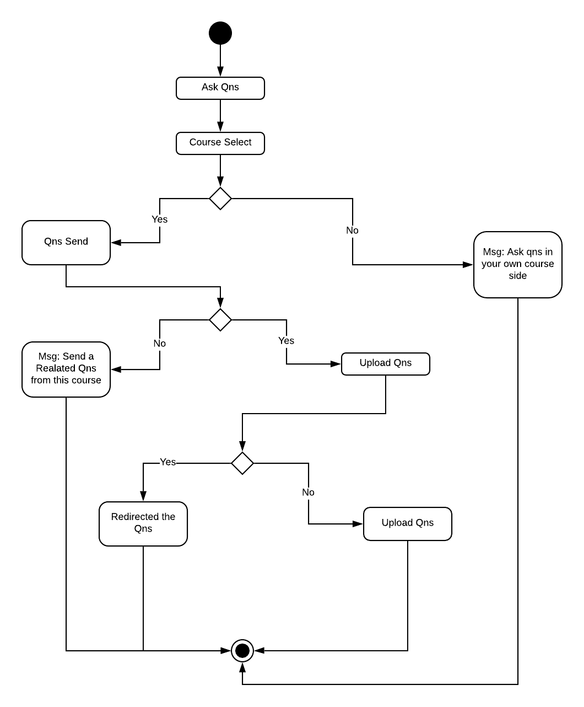
Question and answer
Student can ask question
Answer the question
Vote for answer.

Slide 12


Slide 13
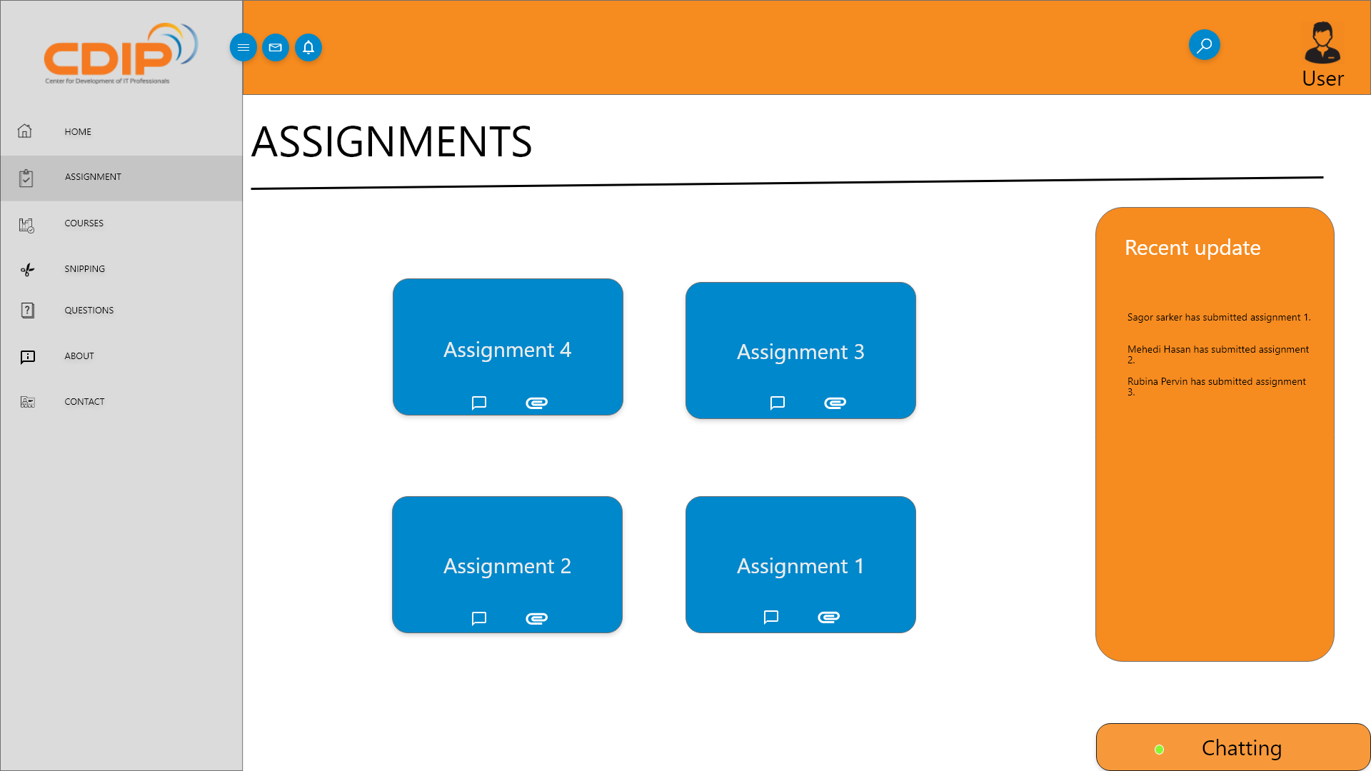
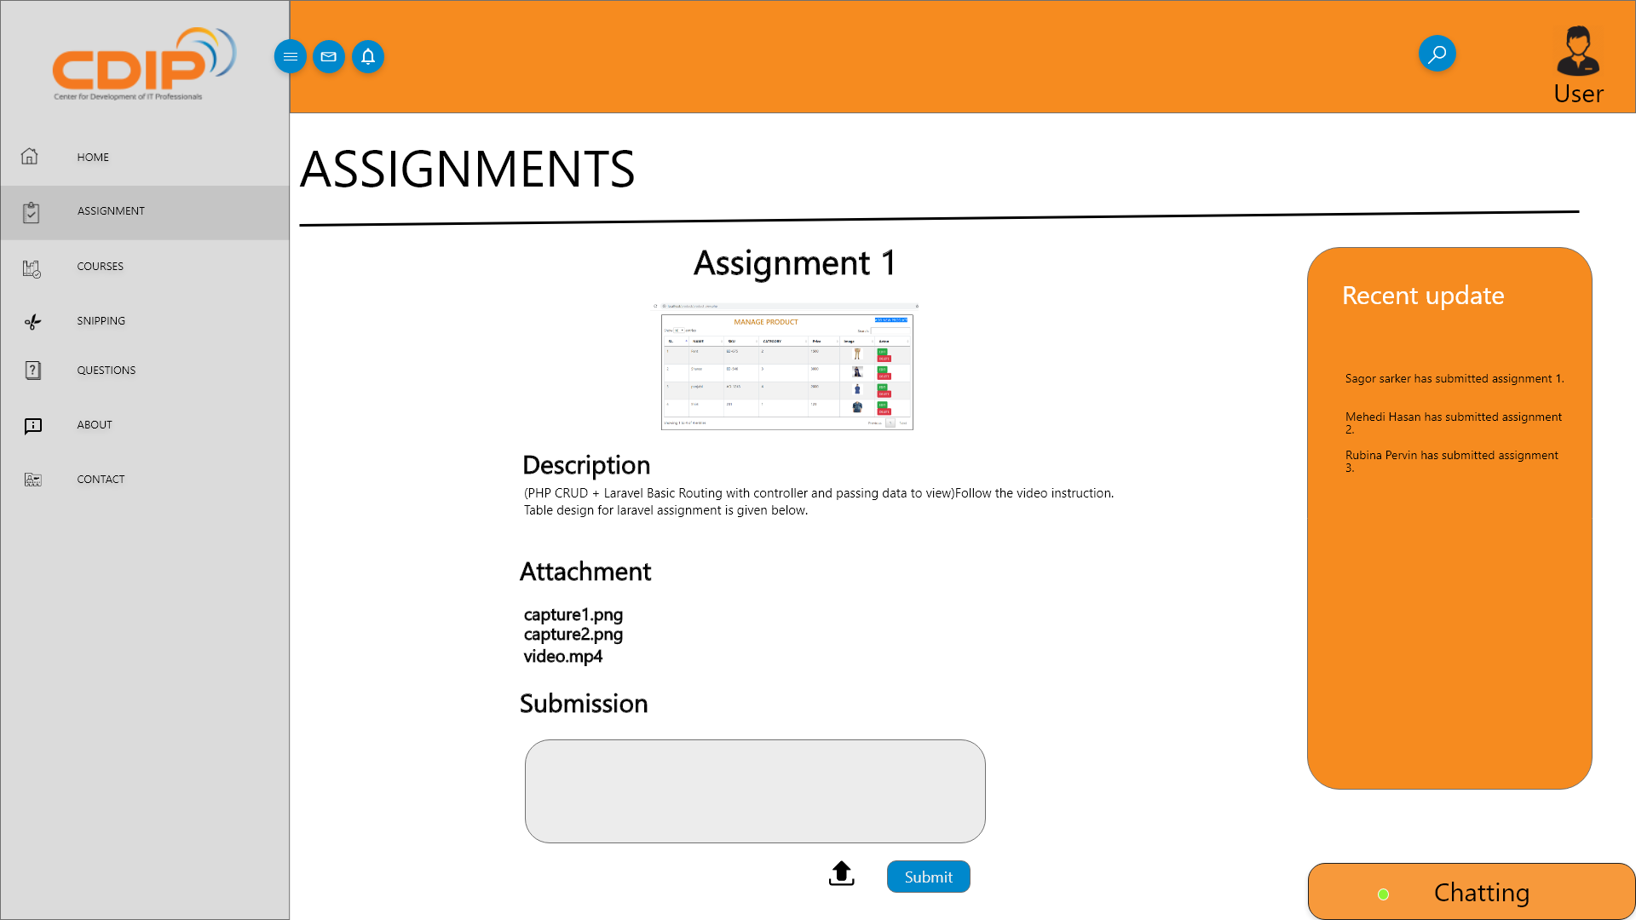
Assignment

Slide 14
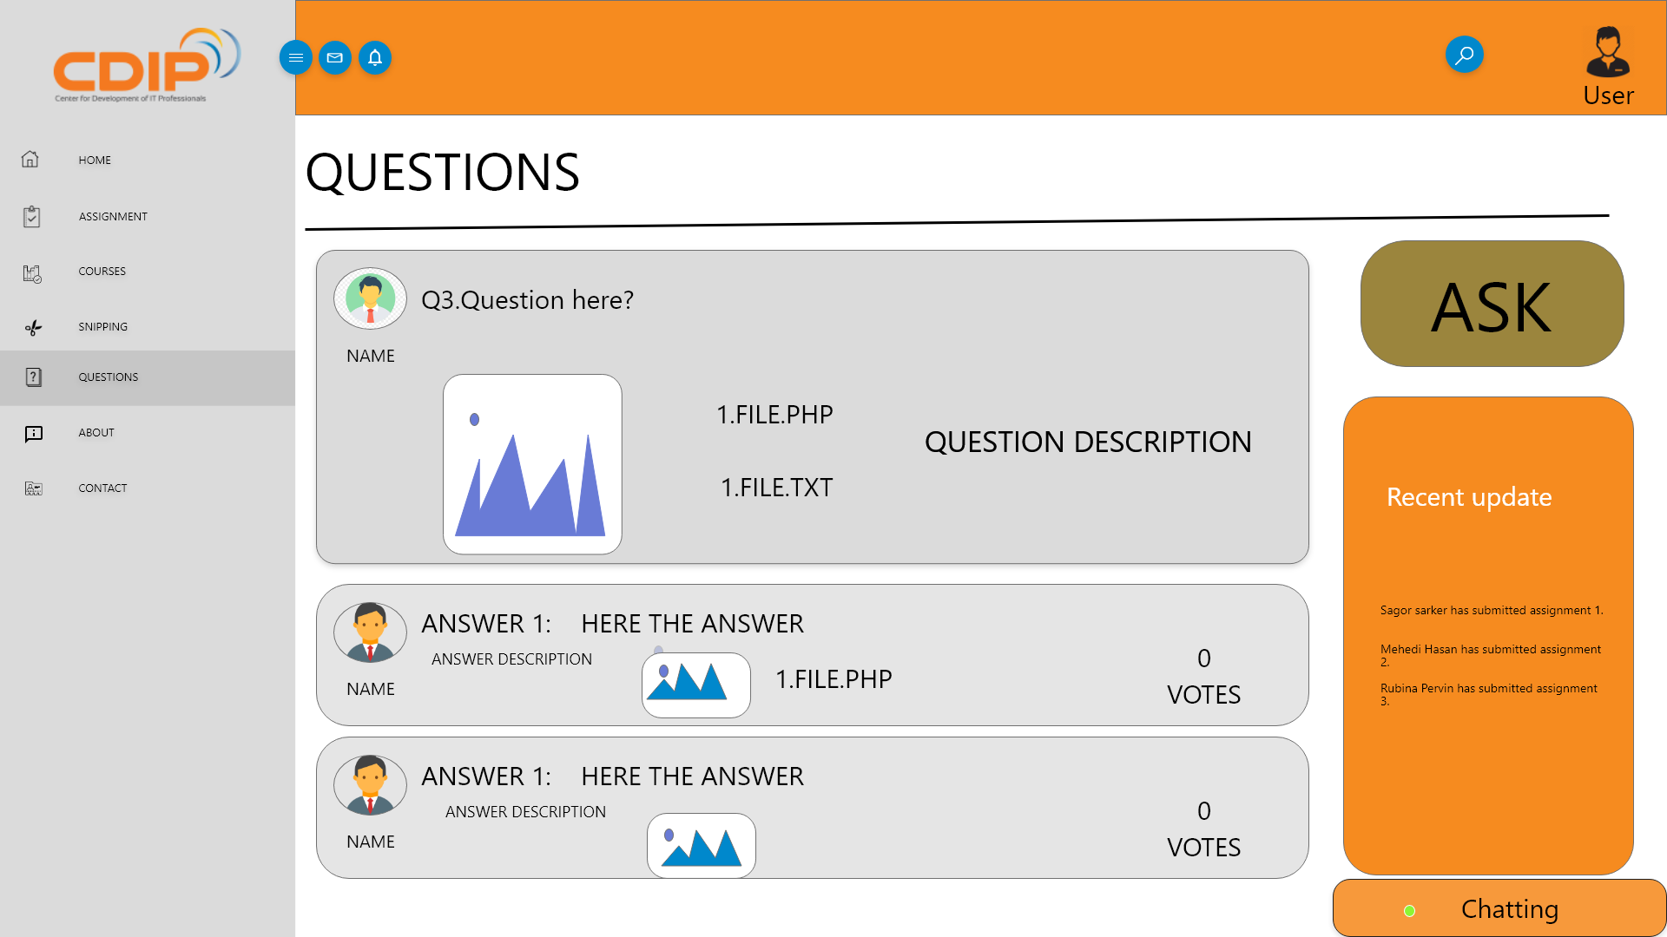
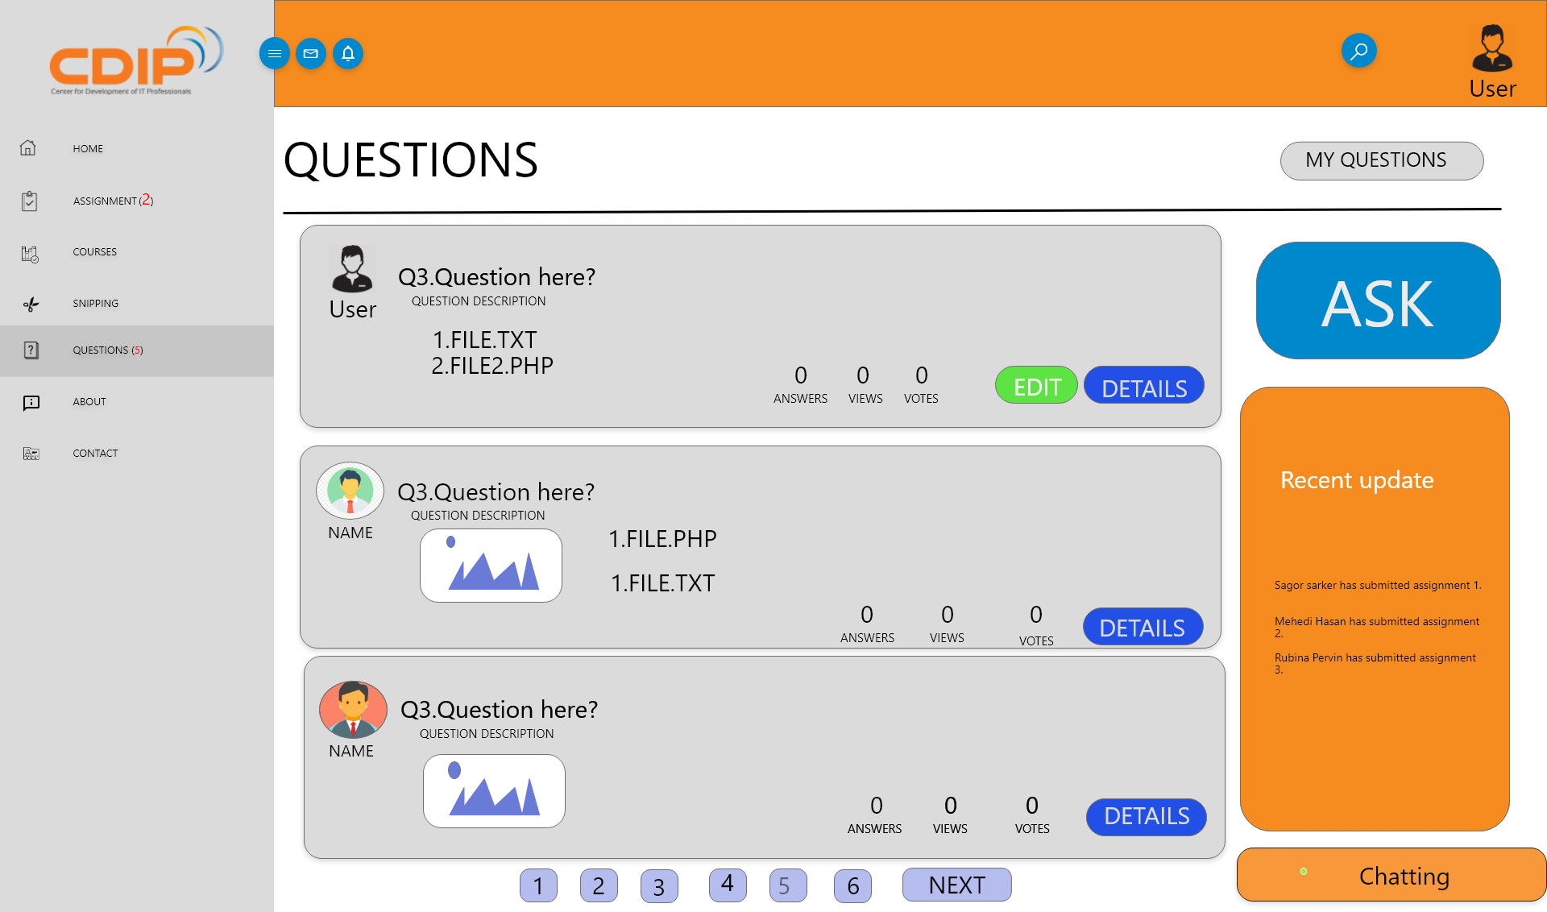
Question and answer

Slide 15


